Slide 1
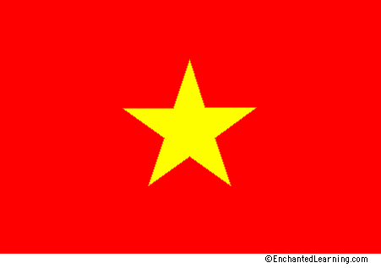
Vietnam War: The Enemy
North Vietnamese Soldiers
and the
Viet Cong

Slide 2
US Went to Vietnam With Noble Purpose
Stop spread of communism
Defend South Vietnam against communists from the North
Our enemies viewed themselves as freedom fighters

Slide 3
Ho Chi Minh – Communist leader of North Vietnam

Slide 4
His metaphor: Elephant and Tiger
If the tiger ever stands still, the elephant will crush him.
The tiger will not stand still. He will leap on the elephant and tear chunks from him and then flee into the jungle.
Such will be the war in Indochina.

Slide 5
Uncle Ho – the father of Vietnam
Traveled to France, Russia, China, US
Charismatic and inspiring
Died before the war ended
Vietnam’s Washington?

Slide 6
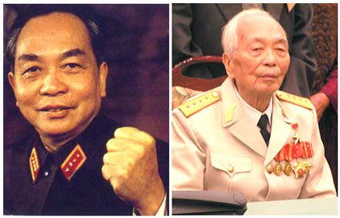
General Giap-Commander NVA
1943 – 34 soldiers
Late 1960s – 1 million
Used Viet Cong to infiltrate the south, terrorize civilians, wear down French…then Americans
Time was on his side
Meaning?

Slide 7
Giap’s Strategy
Hide and make the enemy search for you
Carefully plan and use surprise
Never go head on
Outwait, outsmart, outlast
Use terror
Use propaganda

Slide 8
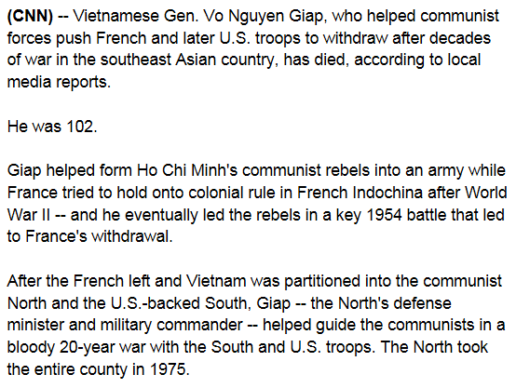
Oct 4, 2013

Slide 9
Ho Chi Minh Trail: Men and supplies

Slide 10
Viet Cong Death Squads
Terrorized hamlets or villages
Caused fear so villagers would not cooperate with US or South Vietnamese armies
Often immoral

Slide 11
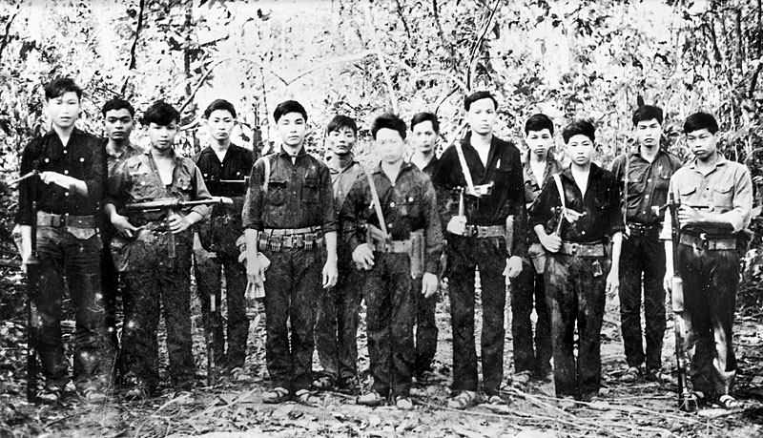
The Enemy

Slide 12
4,000,000 fought
2,000,000 killed or wounded
Ferocious fighters – it is their homeland
Served for the entire war
How does that change your perspective?
Strike and retreat
Often known as “guerilla warfare”
Lots of tunneling
US soldiers “respected” their enemy

