Slide 1
The End of WWI

Slide 2
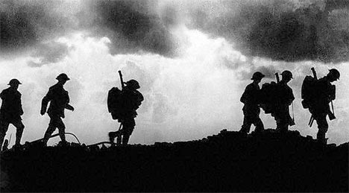
The Armistice
The fighting stopped on the
The 11th hour
The 11th day
The 11th month

Slide 3
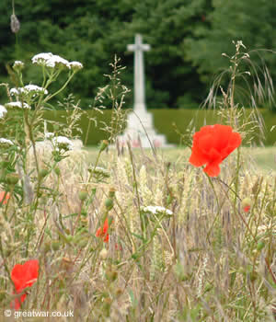
Flanders Fields
Much of WWI was fought on the Western Front.
An area of Belgium, near the French border, is called Flanders.
A generation of French, German and British men died there.
https://www.youtube.com/watch?v=NkKEynoTwp8

Slide 5
Create your own Peace Treaty
Now that you have learned:
How WWI began
Alliance Systems
U.S. Involvement
You are tasked with creating a Peace Treaty to end WWI
You will be presenting your Peace Treaty ideas to the class

Slide 6
In your group
Pick one person to be your scribe
Have out some extra sheets of paper to take notes and write down ideas
Make a rough draft then put your final on the paper provided
Your treaty should include:
A title
A date, remember we are in 1918
Who is the clear loser and who is the clear winner
Punishment(s) for the loser and explanation behind them
YOU MUST HAVE A MAJORITY IN YOUR GROUP AGREE WITH A PUNISHMENT TO PUT IT IN YOUR TREATY

