Slide 1
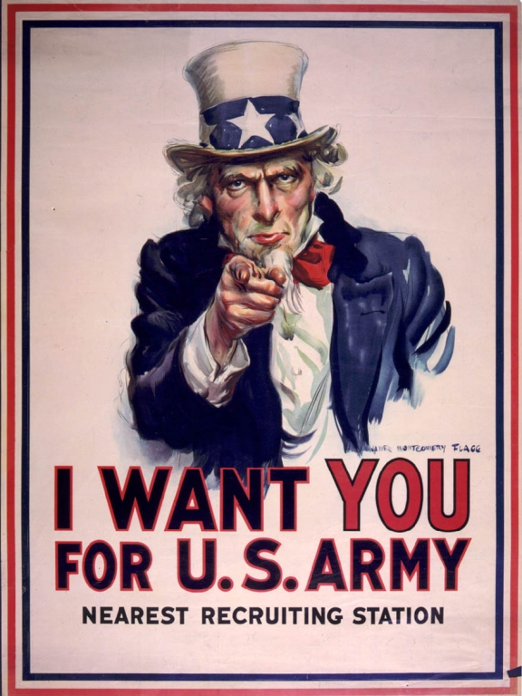
The Military Draft

Slide 2
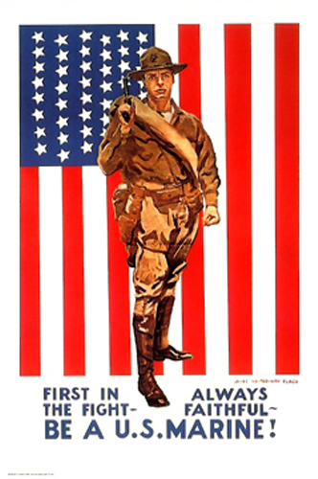
History
Revolutionary War – all volunteers
Civil War
First draft
Wealthy could pay for a substitute
Draft riot in 1863 – 100 people killed
World War I
Time for a draft
President Wilson…”Citizens in a democracy have obligations”
2.8 million men drafted

Slide 3
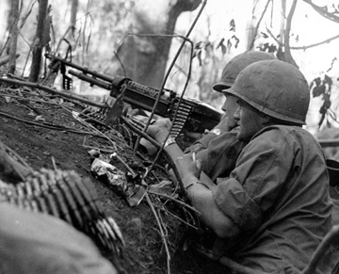
More History
WWII
The Good War
Used a draft….very little protest
1500 local draft boards
Vietnam
Military let local draft boards know what they needed
Many ways to legally get out of the draft
Each board took a different approach

Slide 4
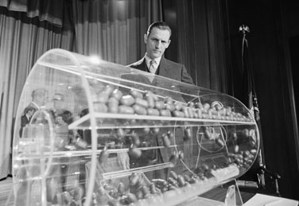
Vietnam Draft
Lottery System
Picked from a barrel of birthdates
Ages 18 – 26
First 1/3 - certain to go
Next 1/3 – “sweat zone”
Last 1/3 – don’t worry, be happy
Local draft board considers exemptions

Slide 5
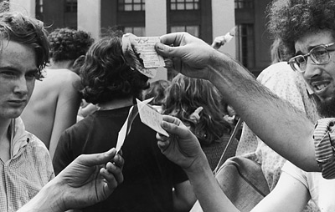
What can I do if I don’t want to go?
Try to get disqualified
Get service “postponed”
Maybe war will soon be over
Resist
Refuse to go
Flee (perhaps to Canada)
Consequences
Jail time, hurt future employment, guilt/self doubt

Slide 6
