Slide 1
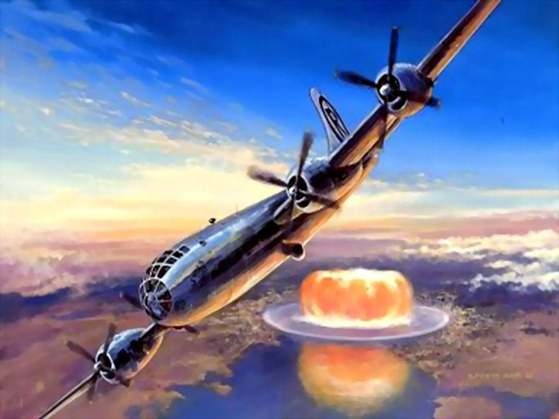
The Atomic Bomb in Perspective

Slide 2
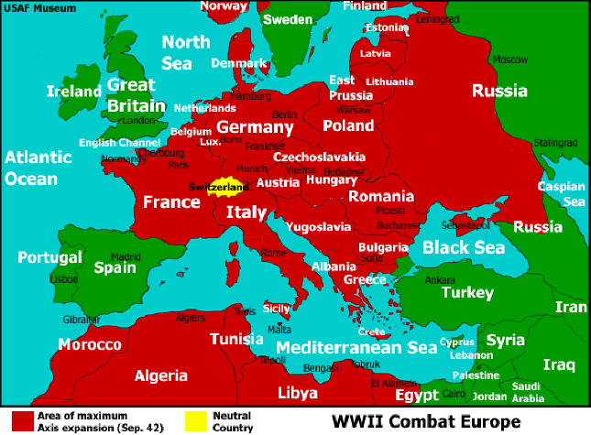
Aircraft bombs-Major factor in Europe!
Germany bombed England
By 1941, 44,000 civilians killed
FDR response: “The ruthless bombing of civilians…has sickened the hearts of every civilized man”
US/British bombing in Europe
Focus on German factories and ability to produce
Early 1945, 2800 British/American bombers attack Dresden (100,000 Germans killed)

Slide 3
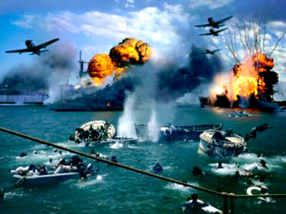
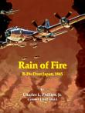
War in Pacific-More bombs
Pearl Harbor-the bombs that got America into war
Mar 1945-US attacks Tokyo
300 B-29 bombers
First 6 hrs-100,000 dead
64 Japanese cities bombed
General Hap Arnold said:
Fire bombing of Japan caused following casualties: 241,000 dead, 313,000 wounded, 2,333,000 houses destroyed

Slide 4
Use of Atomic bomb-factors to consider
American casualties so far in the war
More than 1 million (killed, wounded, missing)
POWs held in Japan were dying of starvation
Americans at home were “war weary”
Estimate of Japanese military strength
5,000,000 men and 5,000 kamikaze (suicide aircraft)
Secretary of War, Harold Stimson: US land invasion of Japan would require 5,000,000 (Army and Navy)

Slide 5
Use of Atomic bomb-factors to consider
Winston Churchill, British Prime Minister recalls….
News of the successful atomic bomb test brought relief that a land invasion could be avoided
War in Europe already over but problems with Soviet Union
Use of the bomb against Japan would serve to warn the Russians who might try to dominate Europe after the war
Massive destruction of the “bomb”
No full understanding of radiation dangers

Slide 6
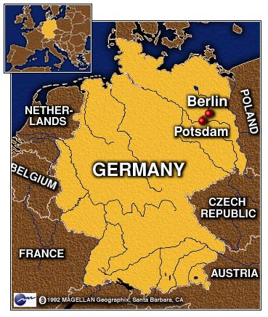
Potsdam Declaration
Clement Attlee
Britain
Joseph Stalin
Russia
Harry Truman
USA

Slide 7
Declaration-Defines Terms of Japanese Surrender (July 26, 1945)
Final warning, no changes, no delays
Removal of leadership that deceived Japanese people
Military disarmed
Justice for war criminals
Will not enslave Japanese or destroy nation
Japanese will retain industry and trade
Occupying forces withdraw when democracy established
Unconditional surrender
If not……prompt and utter destruction

Slide 8
Japanese reaction was mokusatsu – “kill with silence”

Slide 9
Timeline to destruction
Reaction was mokusatsu – “kill with silence”
US reaction
Hiroshima. Aug 6, 1945 (8:16 am)
Headquarters of 2nd General Army, 43,000 soldiers
Aircraft , Enola Gay, dropped 12.5 kiloton nuclear weapon
60% of city destroyed, 80,000 to 140,000 killed
Nagasaki. Aug 9, 1945 (11:02 am)
Major port city with large coal deposits
Aircraft, Bock’s Car, dropped 22 kiloton nuclear weapon
23% of city destroyed, 75,000 killed
Between 12 and 20 US Prisoners of War killed
Aug 15: Emperor Hirohito announces surrender

Slide 10
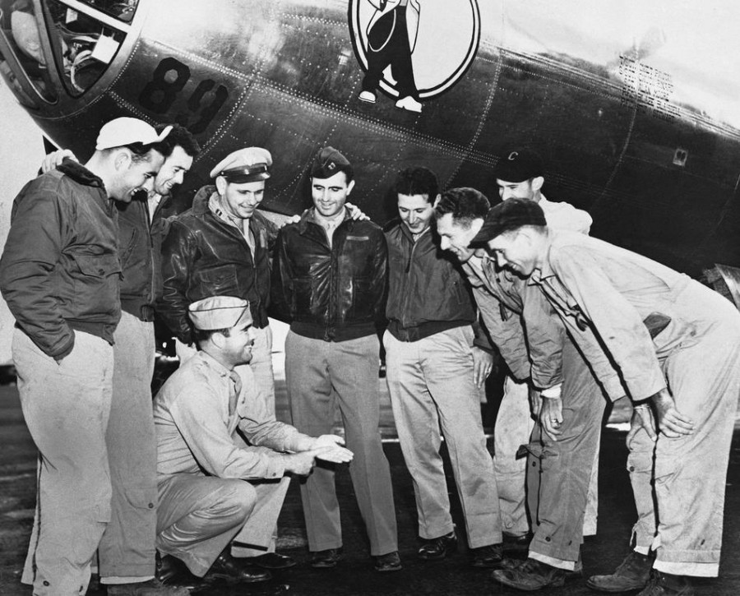
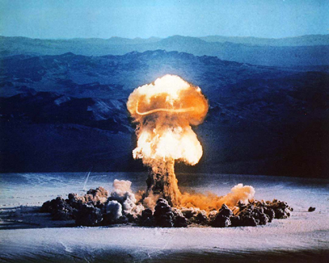
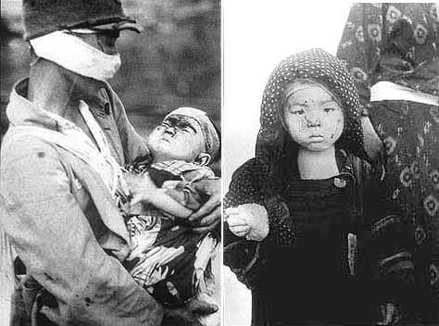
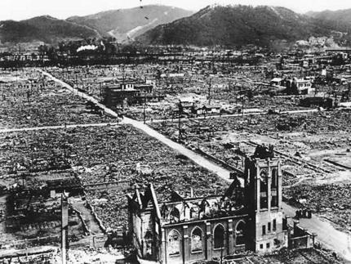
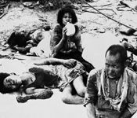
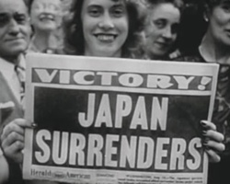
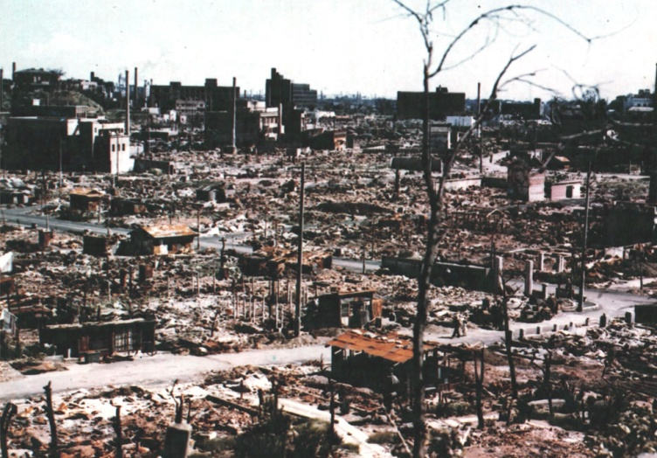
The world enters the Nuclear Age

