Slide 1
The battle of britain

Slide 2
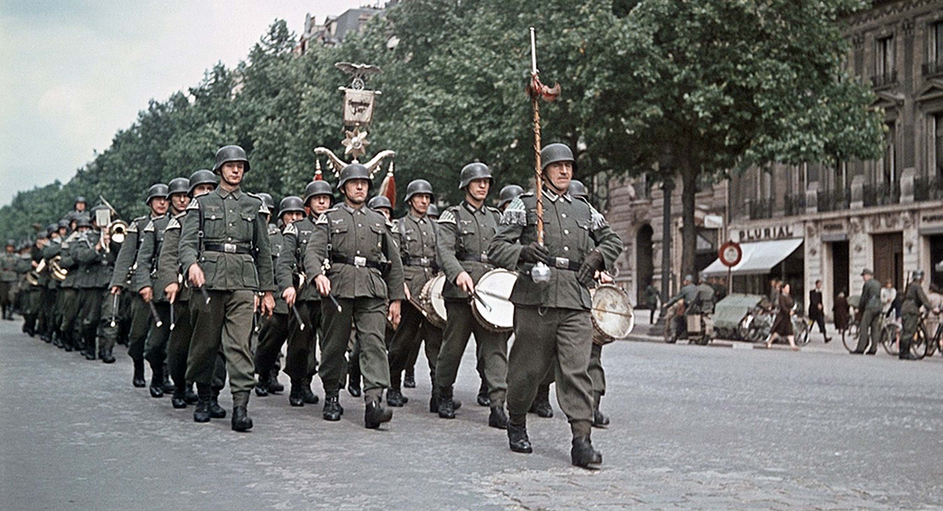
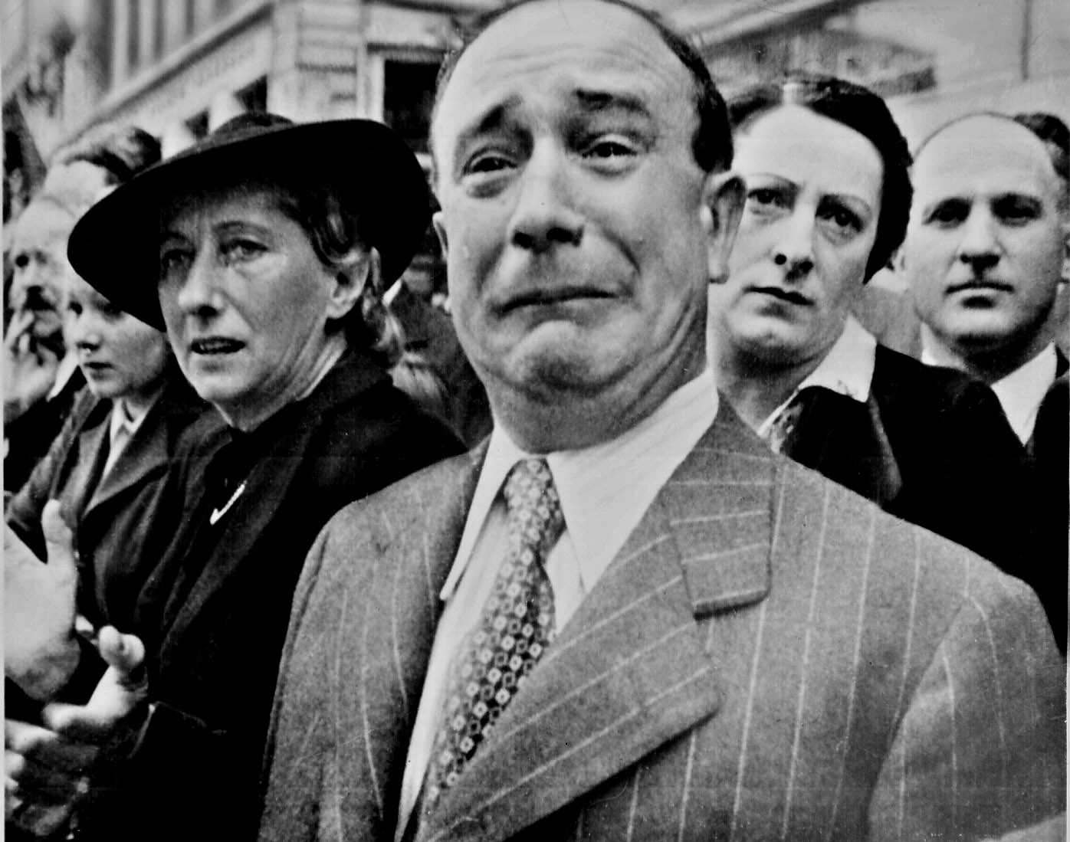
The Defeat of France
Germany turned its attention to France.
Germany rolled across the border on May 10, 1940.
They used a military tactic called a “Blitzkrieg”.
They reached the French capital on June 14th, just three weeks later.

Slide 3
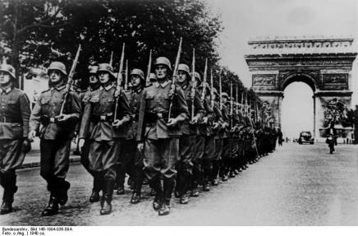
The Defeat of France
The French government escaped to the south, to the Bordeaux region.
Marshall Pertain announced over the radio to the French people … “It is with a heavy heart that I tell you today that we must stop fighting.”

Slide 4
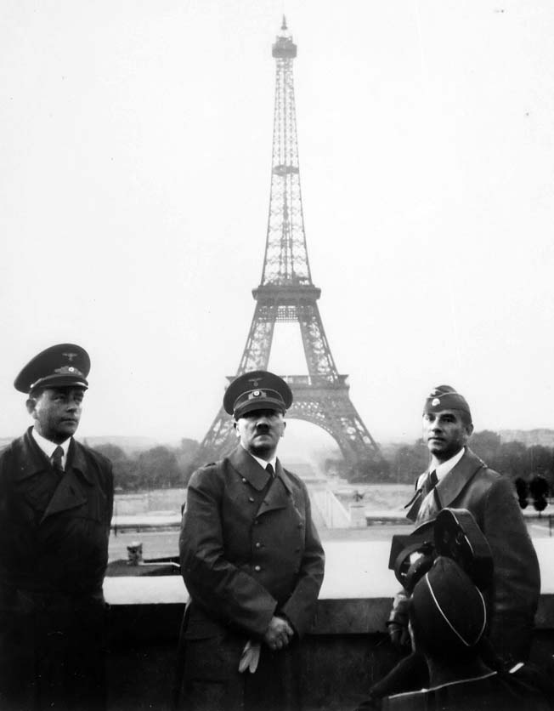
The Defeat of France
Signing the Treaty
Hitler had the train car that was used to sign the WWI treaty, signifying the defeat of Germany, brought out of a museum for the occasion.
The treaty of France’s defeat in WWII was signed in that train car.

Slide 5
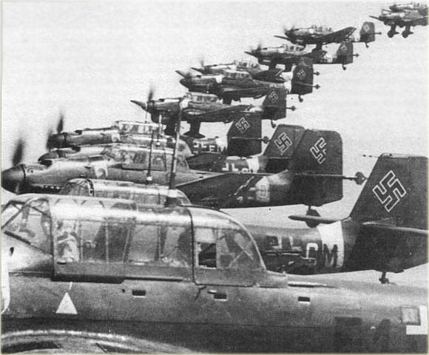
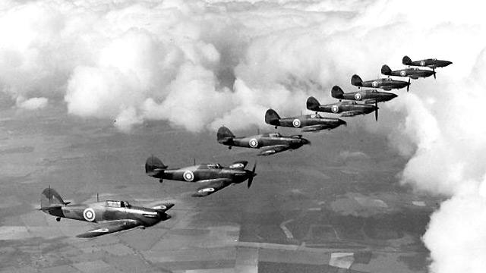
Britain Stands Alone
Now only Great Britain stood between the Nazis and the domination of Europe.
Directive Number 16 – codename Sea lion – began the invasion of Britain starting with an air battle in June 1940.
This was the first battle entirely fought by air forces; the Royal Air Force (RAF) vs. the Luftwaffe.

Slide 6
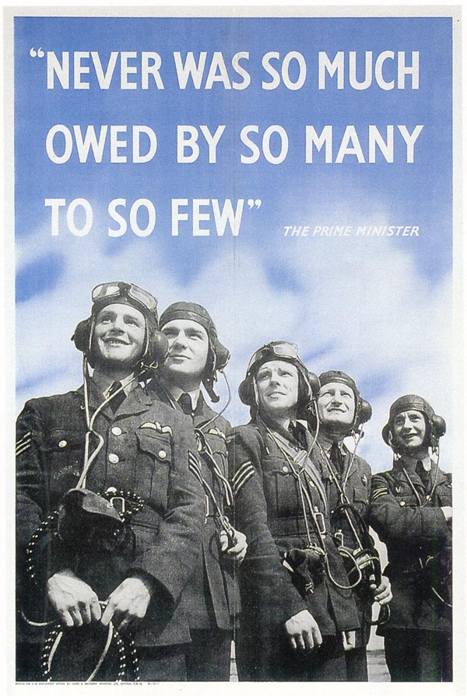
Britain Stands Alone
When speaking to the RAF Churchill said …

Slide 7
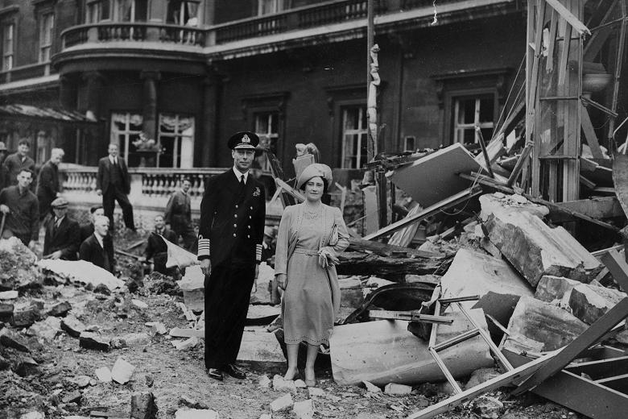
Britain Stands Alone
Churchill said “… upon this battle depends Christian civilization”.

Slide 8
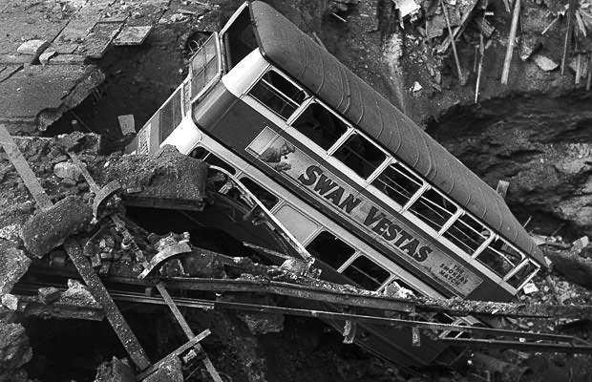
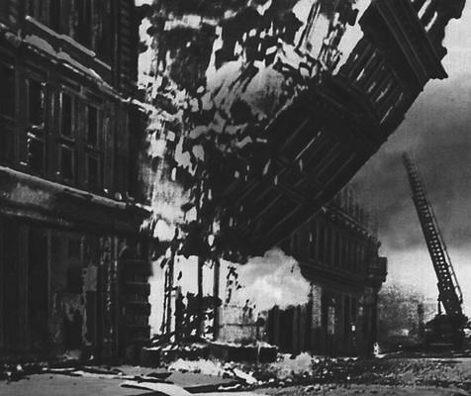
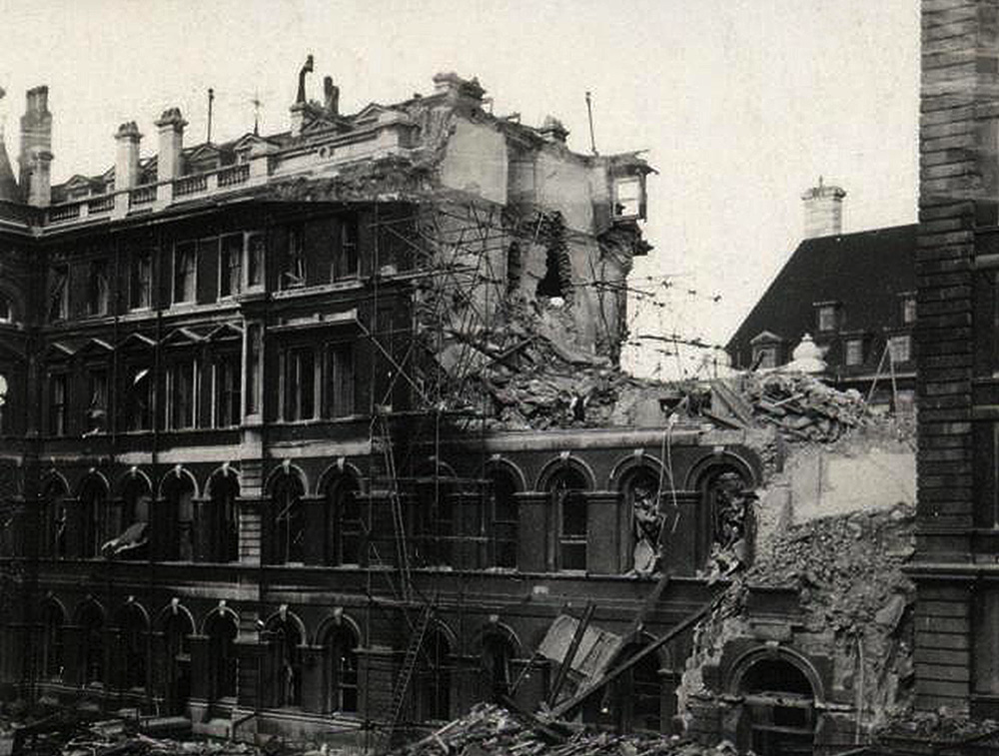
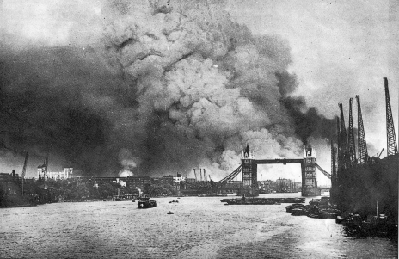

Slide 9
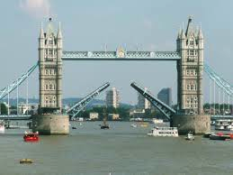

Slide 10
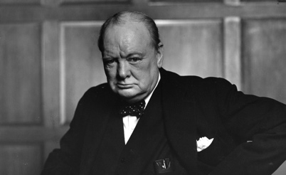
Britain Stands Alone
Churchill delivered a very famous speech
Listen closely to his words: “The new world with all its power and might steps forward to the rescue.”
What was Churchill referring to?

Slide 11
Britain Stands Alone
Your ticket out the door …
If you were Prime Minister Churchill, what would you say to President Roosevelt to convince him to join the fight against the Nazis?

