Slide 1
Three Programs and One Goal
Land on Moon and Safely Return to Earth

Slide 2
Mercury Program
Orbit manned spacecraft around Earth
Determine man’s ability to function in space
Recover both man and spacecraft safely

Slide 3
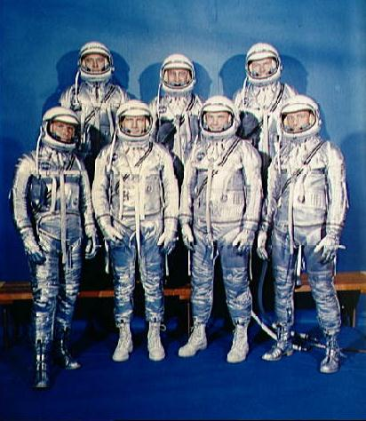
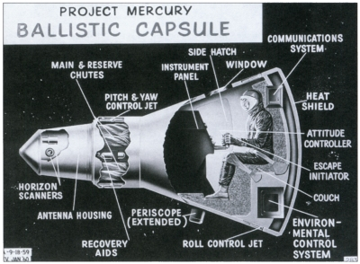
6 flights conducted between May 1961 and May 1963

Slide 4
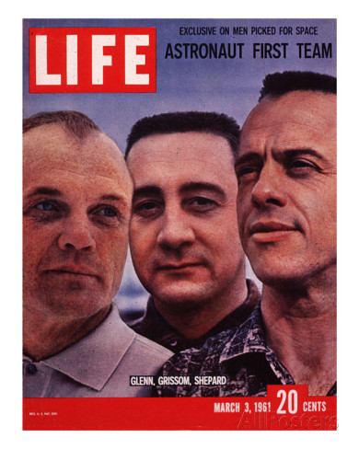
John Glenn: 1st American to orbit Earth
Alan Shepard: 1st American in Space

Slide 5
Gemini Program
Learn how to fly spacecraft
Maneuver in space
Rendezvous and dock with other vehicles

Slide 6
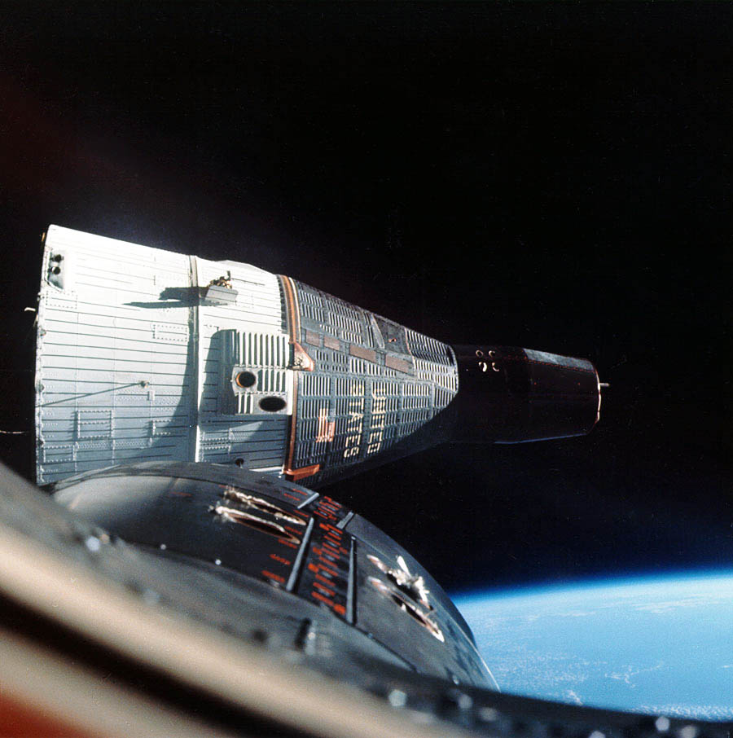
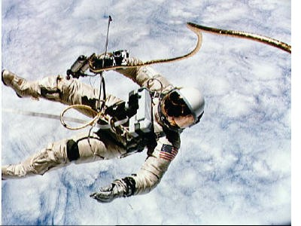
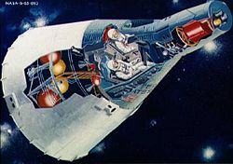
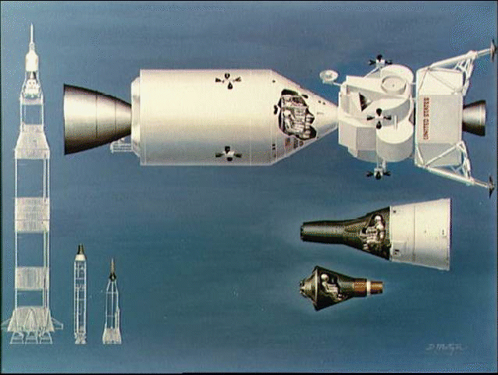
10 missions conducted in a 20 month period between 1965 and 1966

Slide 7
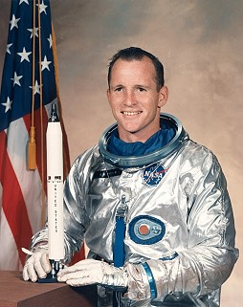
Ed White – 1st American to “walk” in space

Slide 8
Apollo Program
Goal is to land on the moon
45 astronauts flew on Apollo missions
Oct 1968 – July 1975
Twelve men walked on the moon

Slide 9
First to walk on the moon!
Edwin “Buzz” Aldrin
Neil Armstrong

Slide 10
